Slide 1
Event management
Maths in the workplace

Slide 2
How our teaching resources are designed for the classroom

Slide 3
I can understand how maths is used in event management.

Slide 4
A percentage is a proportion of a whole.

Slide 5

Event management
Maths skills in event planning
Planning your own event

Slide 6
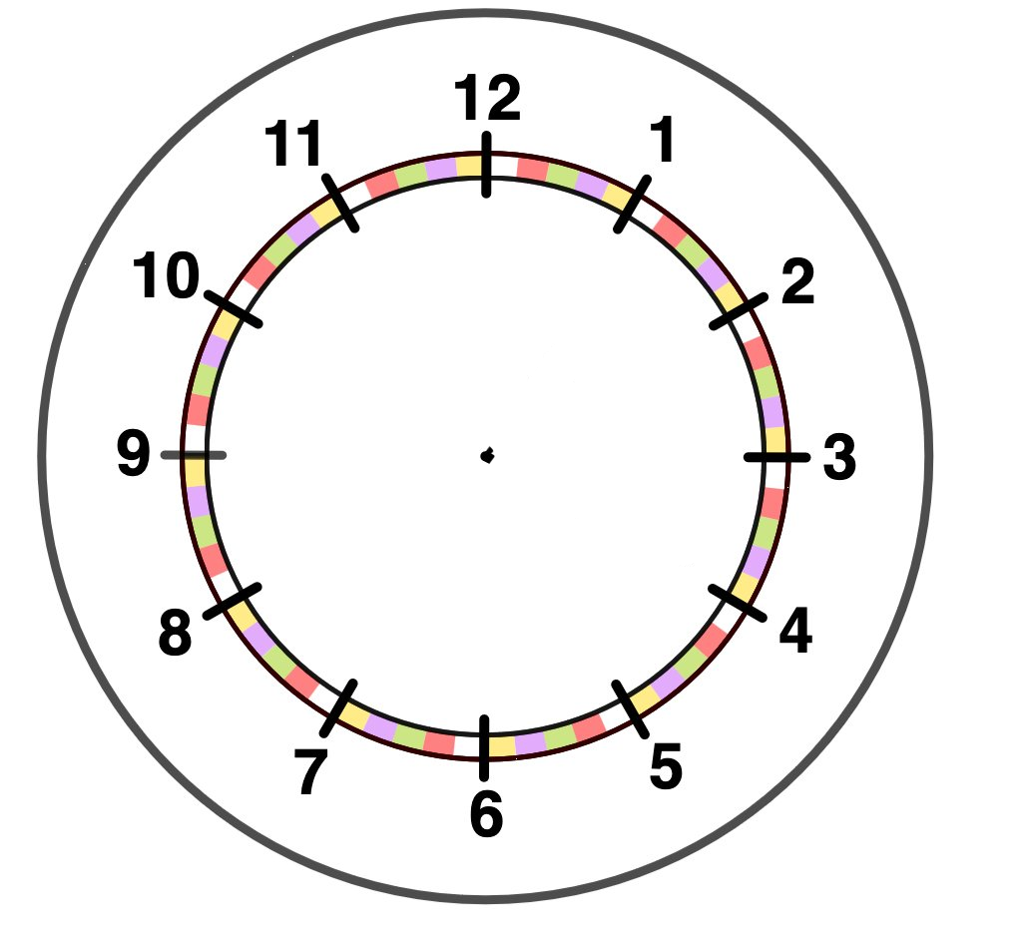


Maths skills in event planning
What areas of maths do you think an event management company might use?
Area
Multiplication
Division
Percentages
Money
Time
Profit & loss
Ratio
During this lesson we will look at some of these.

Slide 7
Maths skills in event planning
One of the most important skills an event planner must have is working to a budget.
Why do you think this is one of the most important skills?
Events will need to be organised in a way that either ‘breaks even’ or makes a profit and not a loss.
It will depend on the type of event as to whether it is a profitable event, or a ‘break even’ event.
What does ‘break even’ mean?
Where there is neither profit nor loss.

Slide 8
Maths skills in event planning
Can you think of any examples of events?
Planning a concert
Planning a music festival
Planning a sports event
Planning a charity event
What might cause these events to ‘break even’ instead of making a profit?
Minimum tickets sales
External factor which affects participation

Slide 9
Maths skills in event planning
Imagine you are planning a charity junior 5-a-side football tournament for 10 teams.
What costs will be associated with organising this event?
E.g.
Hiring the venue
Hiring staff
Hiring toilets
Buying trophies & medals
Supplying refreshments

Slide 10
Maths skills in event planning
You manage to recruit volunteers to staff the event but everything else will need to be costed.
The venue is hired on an hourly basis. You want to hire it for the correct amount of time.
The event will start at 8:30 am and finish at 3 pm.
How long do you need to hire the venue for?
6.5 hours
The cost of hiring the venue is £250 per hour but the venue offer a 10% discount as it is a charity event.
How much will the cost to hire the venue be?
7 × 250 × 0.9 = £1575

Slide 11

Maths skills in event planning
The cost of hiring a 5-a-side pitch is £40 per hour. (The venue offer you a 10% discount.) The cost to hire it between 9 am and 4:30 pm is £270.
Number of hours = 7.5 which means we are charged for 8
Cost = 8 × 40 × 0.9
Cost = £288

Slide 12


Maths skills in event planning
Now let’s hire some toilets.
The cost of hiring a portable toilet is £60 per half day (4 hours) or £100 a day.
Can this event hire the toilets for a half day?
No, the event lasts 6.5 hours.
Therefore, they need to pay the daily rate.
Do you think that 1 toilet is enough for this event?
It probably is not.
Let’s look at an estimate for the number of people attending.
That’s not going to have much of an impact on the total cost of the event. It is only £100.

Slide 13
Maths skills in event planning
The event is a charity junior 5-a-side football tournament for 10 teams.
What would be a sensible estimate of the number of people attending the tournament?
It would consist of the team members, their supporters and staff.
How many players will there be?
10 teams of 5. But, each team will probably bring reserve players.
If we assume each team consists of 10 players and each player has 1 supporter.
How many people is this?
10 × 10 × 2 = 200
Assume that there are 50 volunteers.
An estimate of the total number of people attending the tournament is 250 people.

Slide 14
Maths skills in event planning
Do you think that 1 toilet for 250 people is reasonable?
No, although this would make more money for the charity, safety and comfort should be considered.
After an internet search I have discovered that the recommended ratio of toilets to people at an event is 1 : 100
How many toilets should be hired for this event?
250 ÷ 100 = 2.5
3 toilets need to be hired for the event.
Cost of hiring the toilets = 3 × £100 = £300

Slide 15
Maths skills in event planning
The number of toilets needed for an event with an attendance of 820 people is 8 assuming the recommended ratio of toilets to people is 1 : 100.
820 ÷ 100 = 8.2
In this situation you need to round up to 9 toilets.

Slide 16
Maths skills in event planning
Since this is a charity event, the company supplying the refreshments agrees to do this for free.
Now we need to find the cost of the trophies and medals.
Each team has 10 players.
The winners and runners up each get a team trophy and trophy for each player. All other players get a participation medal.
Calculate the total cost of buying the trophies and medals.
Award | Cost per item
Team trophy for 1st two teams | £12.50
Trophy for winners and runners up | £5.50
Participation medal | £1

Slide 17
Maths skills in event planning
There are 10 teams and each team has 10 players.
The winners and runners up each get a team trophy and trophy for each player. All other players get a participation medal.
Award | Cost per item
Team trophy for 1st two teams | £12.50
Trophy for winners and runners up | £5.50
Participation medal | £1
Calculate the total cost of buying the trophies and medals.
What needs to be purchased?
2 team trophies
20 winners and runners up trophies
80 participation medals
Total cost = 2 × £12.50 + 20 × £5.50 + 80 × £1
= £215

Slide 18
Maths skills in event planning
There are 8 teams and each team has 7 players.
The winners and runners up each get a team trophy and trophy for each player. All other players get a participation medal.
Calculate the total cost of buying the trophies and medals.
Award | Cost per item
Team trophy for 1st two teams | £12.50
Trophy for winners and runners up | £5.50
Participation medal | £1
What needs to be purchased?
2 team trophies
14 winners and runners up trophies
42 participation medals
Total cost = 2 × £12.50 + 14 × £5.50 + 42 × £1
= £144

Slide 19
Maths skills in event planning
The event organiser wants to make a profit of at least £750.
What should the average ticket price be?
Total cost to run the event = £1575 + £300 + £215
= £2090
Total income from the event needs to be = £2090 + £750
= £2840
Average ticket cost = £2840 ÷ 250
= £11.36
From here we can decide which tickets should cost more and which could cost less.

Slide 20
Maths skills in event planning
1) The cost of hiring a venue is £45 per hour.
Calculate the cost of hiring a venue for the following time periods:
a) 2 pm to 5 pm
b) 8:30 am to 4:30 pm
c) 7:45 am to 6:00 pm

Slide 21
Maths skills in event planning
2) To make your event more comfortable for people you decide to use the ratio of 1 : 75 for the toilets to people. The cost of hiring a toilet is £120.
Calculate the cost of hiring toilets for the following numbers of people:
a) 1500 people
b) 3200 people
c) 400 people

Slide 22
Maths skills in event planning
3) Calculate the cost of trophies and medals for the following:
a) 7 teams of 8 players
b) 12 teams of 12 players
c) 10 teams of 15 players
Award | Cost per item
Team trophy for 1st two teams | £12.50
Trophy for winners and runners up | £5.50
Participation medal | £1

Slide 23
Maths skills in event planning
d) Using your answers to the previous questions calculate the average ticket price if the profit needs to be at least £1000.
7:45 am to 6:00 pm with a 20% discount as it is a charity event.
10 teams of 15 players
400 attendees

Slide 24
Maths skills in event planning
1) The cost of hiring a venue is £45 per hour.
Calculate the cost of hiring a venue for the following time periods:
a) 2 pm to 5 pm 3 × £45 = £135
b) 8:30 am to 4:30 pm 8 × £45 = £360
c) 7:45 am to 6:00 pm 11 × £45 = £495

Slide 25
Maths skills in event planning
2) To make your event more comfortable for people you decide to use the ratio of 1 : 75 for the toilets to people. The cost of hiring a toilet is £120.
Calculate the cost of hiring toilets for the following numbers of people:
a) 1500 people 1500 ÷ 75 = 20 20 × £120 = £2400
b) 3200 people 3200 ÷ 75 = 42.666… 43 × £120 = £5160
c) 400 people 400 ÷ 75 = 5.333… 6 × £120 = £720

Slide 26
Maths skills in event planning
3) Calculate the cost of trophies and medals for the following:
a) 7 teams of 8 players
2 × £12.50 + 16 × £5.50 + 40 × £1
= £153
b) 12 teams of 12 players
2 × £12.50 + 24 × £5.50 + 120 × £1
= £277
c) 10 teams of 15 players
2 × £12.50 + 30 × £5.50 + 120 × £1
= £310
Award | Cost per item
Team trophy for 1st two teams | £12.50
Trophy for winners and runners up | £5.50
Participation medal | £1

Slide 27
Maths skills in event planning
d) Using your answers to the previous questions calculate the average ticket price if the profit needs to be at least £1000.
7:45 am to 6:00 pm with a 20% discount as it is a charity event.
10 teams of 15 players
400 attendees
Cost of venue = £495 × 0.8 = £396
Cost of toilets = £720
Cost of trophies and medals = £310
Total income needs to be = £1426 + £1000 = £2426
Average ticket price = £2426 ÷ 400 = £6.07
We can now decide what tickets should cost more and which cost less.

Slide 28
Event management
Maths skills in event planning
Planning your own event

Slide 29
Planning your own event
What costs are associated with planning a birthday party?
Invitations (£4.99 for a pack of 20)
Hiring a venue (Small hall £25 per hour, large hall £70 per hour)
Entertainment (Children’s entertainer £110 per hour, disco £25 per hour, bouncy castle £120 a day)
Catering (£7.50 per head)
Party bags (£2.70 per child)

Slide 30
Planning your own event
Let’s calculate the cost of a birthday party for 30 children.
They would like an entertainer.
A small venue will be fine for 30 children.
The party will be from 2 pm until 5 pm.
Invitations
Venue hire
Entertainment
Catering
Party bags
Packs of 20 for £4.99, 2 × £4.99 = £9.98
3 hours at a small venue, 3 × £25 = £75
Children’s entertainer for 2 hours = 2 × £110 = £220
30 × £7.50 = £225
30 × £2.70 = £81
Total cost = £610.98

Slide 31
Planning your own event
It is important to consider different vendors/suppliers when planning an event.
You might be able to get a better deal elsewhere or find ways to save on costs so you can maximise profit or minimise expenditure.

Slide 32
Planning your own event
1) Plan your own event.
Choose from the following:
A charity tournament making at least £500 for your favourite charity. What should the cost per ticket be?
A non-profit event, a child’s birthday party with a budget of £800. How many children can be invited?
A music concert in which you need to make a profit of 20%.
Or something of your own choice.
You can use the internet to research costs of venues, catering, etc in your area. Or use the ones provided in this lesson.

Slide 33
Planning your own event
1) Plan your own event.
Choose from the following:
A charity tournament making at least £500 for your favourite charity. What should the cost per ticket be?
A non-profit event, a child’s birthday party with a budget of £800. How many children can be invited?
A music concert in which you need to make a profit of 20%.
Or something of your own choice.
You can use the internet to research costs of venues, catering, etc in your area. Or use the ones provided in this lesson.

Slide 34
Planning your own event
1) E.g. Planning an obstacle course birthday party for a group of children.
Gold level package - £28.50 per child
Party bag with medal, wrist band and pencil - £6.99 per child
Pizza - 1 large pizza at £25.99 each (1 large per 2 children). 45% party discount and free delivery.
Cost for two children = 85.2745 (unrounded value at this stage)
Budget = £800
800 ÷ 85.2745 = 9.381… so nine pairs of children can be invited.
18 children can be invited to the party. Party cost total = £767.47

Slide 35
Event management
Many areas of maths are used in event management.
During this lesson we mainly focused on costs associated with planning an event.
Ensuring safety and comfort are addressed is an important factor when deciding on, for example, the number of toilets required for an event.
Many events will have a budget which may limit some aspects of the event.

Slide 36

© Oak National Academy 2024.
Produced in partnership with Mathematics in Education and Industry.
Licensed on the Open Government Licence v3.0, except where otherwise stated. See Oak terms and conditions.

